Slide 1
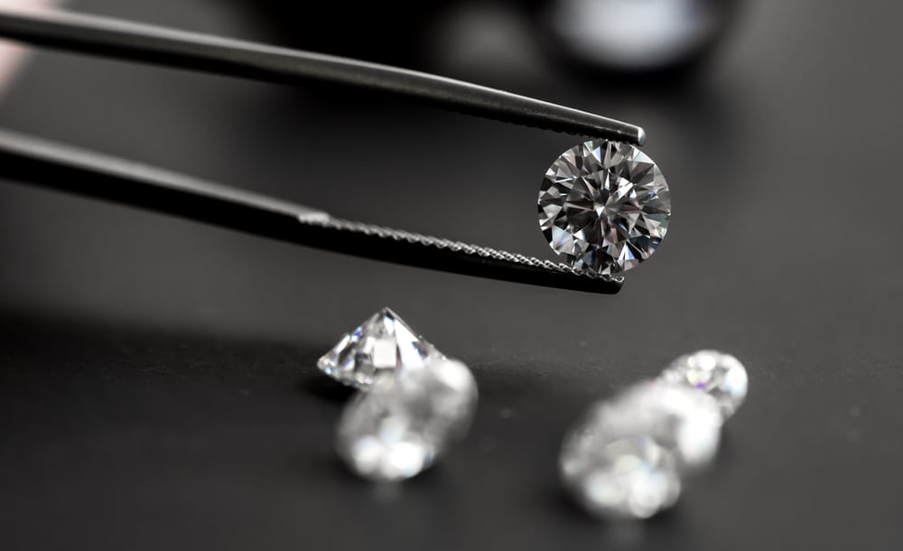
Diamonds Price
Based on ~54K diamonds features and price we’ll build our prediction models

Slide 2
Objective
This project aims to answer these questions
What is the most feature affect the price ?
What are the most four features you should look into it when you want to buy a diamond ?
What is the best model to predict the price of a diamond ?
Context
We have a dataset of 53920 rows
Each row contain 9 features and the price

Slide 3
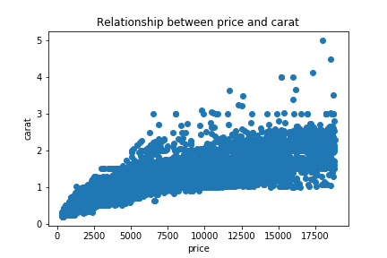
Diamonds features I
carat: weight of the diamond, (min:0.2 - max:5.01)
Carat it has the most impact on diamond price (correlation coefficient of .92) ,So if we have a diamond with 1 carat and other diamond with 2 carat, with same quality we’ll see a high difference on price.
price: price in US dollars ($326 - $18,823)

Slide 4
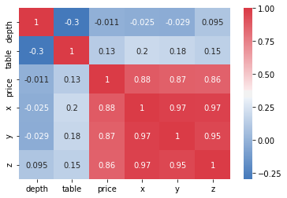
Diamonds features II
x length: in mm (0 - 10.74),
y width: in mm (0 - 58.9),
z depth: in mm (0 - 31.8)
depth: in mm (43 - 79)
table: in mm (43 - 95)

Slide 5
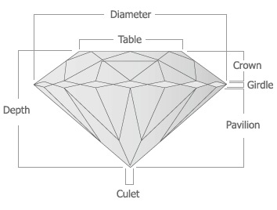
Depth: The Height of a Diamond, measured from the Culet to the table, divided by its average Girdle Diameter - depth = z / mean(x, y) = 2 * z / (x + y)
Table: width of top of diamond relative to widest point

Slide 6
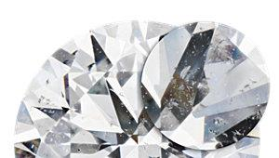
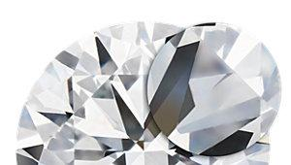
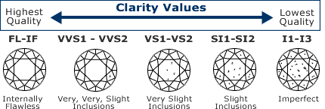
Diamonds features III
Clarity Increase | Price Increase (%)
SI2-SI1 | 12%
SI1-VS2 | 22%
VS2-VS1 | 9%
VS1-VVS2 | 13%
VVS2-VVS1 | 28%
VVS1-IF | 22%
Clarity: a measurement of how clear the diamond is IF(best), VVS1, VVS2,VS1,VS2,SI1,SI2,I1(worst)
A diamond’s birthmarks are known as ‘inclusions’ or ‘blemishes’, To grade a diamond’s clarity, a diamond grader uses a lens with 10X magnification, with industry standard
S1
IF

Slide 7
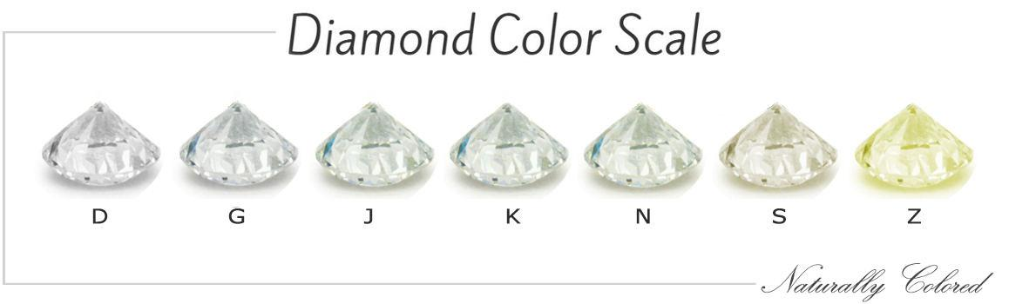
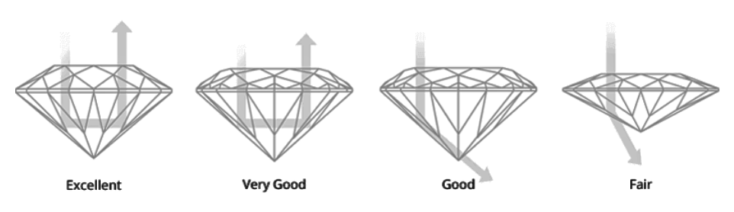
Color: diamond color, from D (best) to J (worst)
Colorless (D - F)
Near Colorless (G - J)
Faint Color (K - M)
Very Light Color (N - R)
Light Color (S - Z)
Cut: quality of the cut, (Fair, Good, Very Good, Premium, Ideal)
Cut refers to a diamond's proportions, symmetry and polish, determines how well the diamond sparkles.

Slide 8
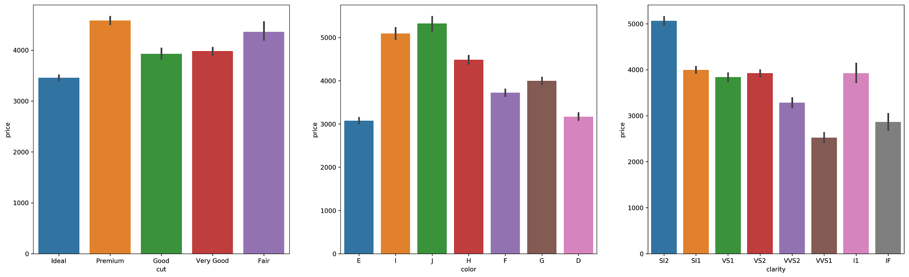
Average price with each category

Slide 9
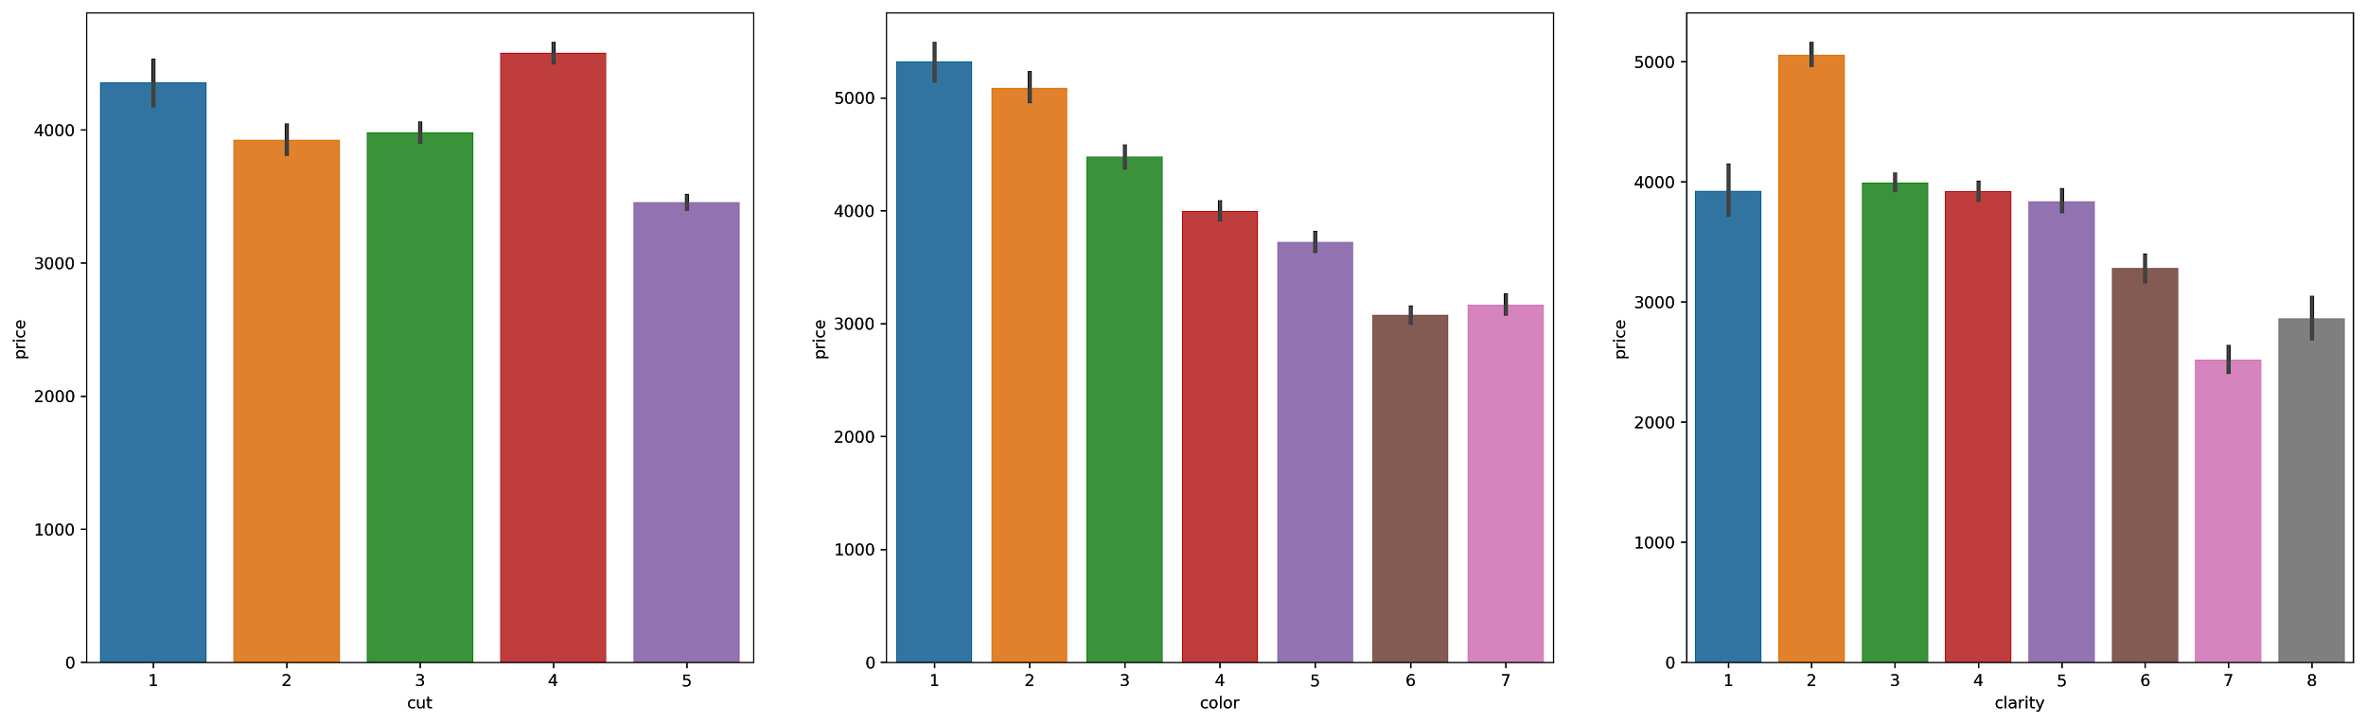
Encoding, The highest the best

Slide 10
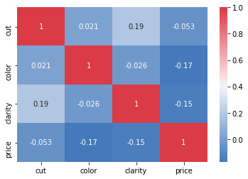
So..
All of them are negatively correlated to price
Cut has a negative correlation coefficient of 0.53
Color and clarity under 0.2

Slide 11
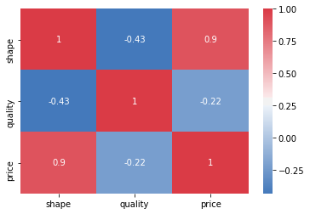
Feature Engineering
Shape = x * y * z
Quality = cut + color + clarity

Slide 12
Regression Modeling
Regression is is a supervised learning. Given a training set of data containing observations and their associated continuous outputs, the goal of regression is to explore the relationships between the observations (also called features) and the targets, and to output a continuous value based on the input features of an unknown sample. from Python Machine Learning By Example by By Yuxi Liu
Linear Regression
Decision Tree Regression
Random Forest Regression
Adaboost Regression
Random Sample consensus
We have three lists of features
All features
Above .50 correlation coefficient cut, shape, carat
Best 4 features Carat, Shape, Clarity, Color

Slide 13
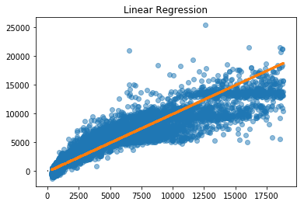
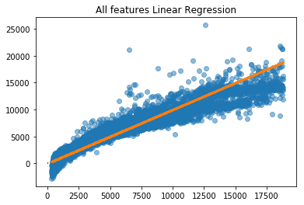
Linear Regression I
MAE : 973.39 MSE : 2201541.10 RMSE : 1483.76 R2 : 0.86
MAE : 836.79 MSE : 1416443.10 RMSE : 1190.14 R2 : 0.91

Slide 14
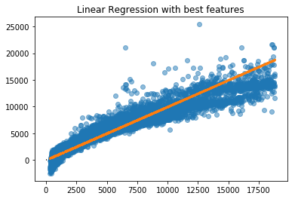
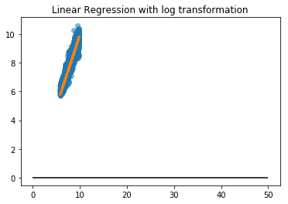
Linear Regression II
MAE : 845.20 MSE : 1445483.57 RMSE : 1202.28 R2 : 0.91
MAE : 0.20 MSE : 0.06 RMSE : 0.25 R2 : 0.94

Slide 15
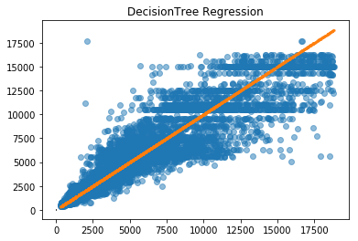
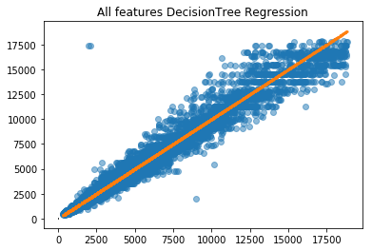
Decision Tree
MAE : 781.66 MSE : 1863837.60 RMSE : 1365.22 R2 : 0.88
MAE : 346.91 MSE : 424211.56 RMSE : 651.32 R2 : 0.97

Slide 16
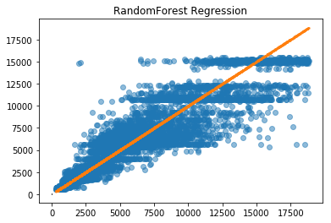
Random Forest
MAE : 778.60 MSE : 1813330.95 RMSE : 1346.60 R2 : 0.88

Slide 17
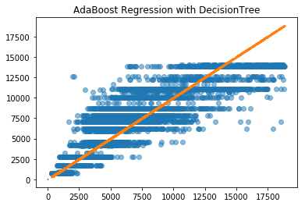
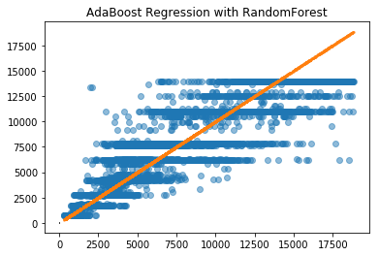
AdaBoost Regressor
MAE : 957.01 MSE : 2427728.55 RMSE : 1558.12 R2 : 0.85
MAE : 877.90 MSE : 2112665.71 RMSE : 1453.50 R2 : 0.87

Slide 18
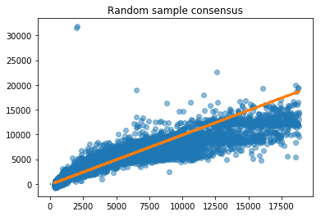
Random Sample Consensus
MAE : 927.65 MSE : 2510475.48 RMSE : 1584.45 R2 : 0.84

Slide 19
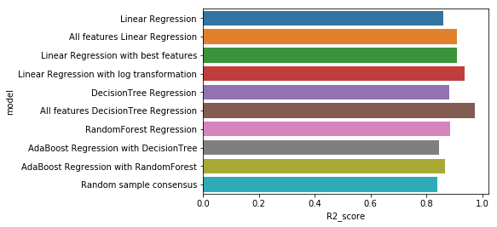
R2 score

Slide 20
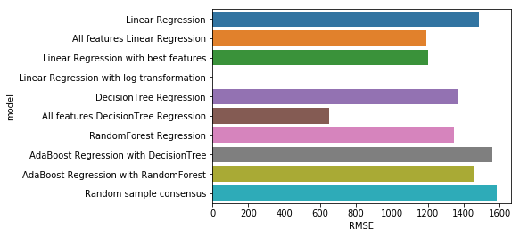
RMSE

Slide 21
Conclusion
What is the most feature affect the price ?
Carat with 0.92 correlation coefficient
What are the most four features you should look into it when you want to buy a diamond ?
Carat, Shape, Clarity, Color
What is the best model to predict the price of a diamond ?
Decision Tree with all features

Slide 22
Resources
The dataset
Diamond color
Diamond cut
More on cut
Diamond clarity
More on clarity

Slide 23
Thank You
If you are not having fun, you’re not learning, there’s a pleasure in finding things out.
Richard Feynman
Abdulaziz Alawshan Email: Abdulaziz.aloshin@gmail.com Blog: www.3zcs.me/blog Twitter: @3zcs

